Slide 1
Java Basics
JS OOP/Closure, JS & DOM / XPATH
Java workshop training, August,2017.
Dr. Kishore Biswas (Forrest/柯修)
PhD. Artificial Intelligence—Natural Language Processing.
CanWay IT Training ®.

Slide 2
Contents
1) JS OOP/Closure
2) JS & DOM / XPATH

Slide 3
1) JS OOP/Closure

Slide 4
TO-DO list
Define JavaScript
Set up environment
Revisit OOP concepts
Look at JavaScript basics
Delve into JavaScript’s core concepts and concerns

Slide 5
Intro to JavaScript
A lightweight language used to save server round-trips for simple tasks such as form validation
Always run inside a host environment (i.e. browser)
Provide behaviors for a web page
JavaScript started inside web pages, but today it's practically everywhere
Web page
Content (HTML)
Behavior (JavaScript)
Presentation (CSS)

Slide 6
Intro to JavaScript (cont.)
Applications:
Create rich and powerful web apps (i.e. Gmail)
Write server-side code such as ASP scripts or, for example, code that is run using Rhino (a JavaScript engine written in Java)
Create rich media apps (Flash, Flex) using ActionScript
Write scripts that automate administrative tasks on your Windows desktop, using Windows Scripting Hosts
Write extensions/plugins for a plethora of desktop application such as Firefox, Dreamweaver, and Fiddler
Create web apps that store information in an off-line database on the user's desktop, using Google Gears
Create Yahoo! Widgets, Mac Dashboard widgets, or Adobe Air apps that run on your desktop
etc.

Slide 7
Intro to JavaScript (cont.)
Built-in features:
Lightweight
Imperative and structured
Dynamic
Dynamic typing, object-based, run-time evaluation
Functional
1st-class function, inner function and closure
Prototype-based
Prototype, function as constructor object, function as method
Others
Syntactic sugars, RegEx, implicit objects, etc.
Vendor-specific extensions

Slide 8
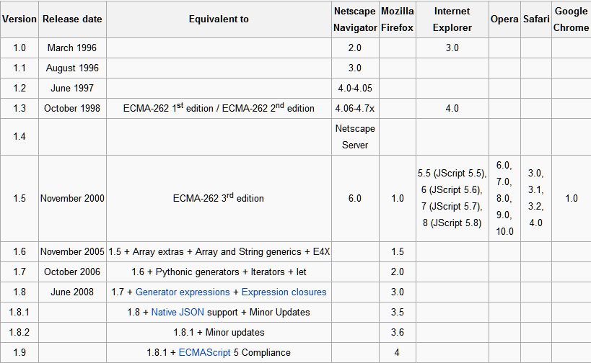
Intro to JavaScript (cont.)

Slide 9
TO-DO list
Define JavaScript
Set up environment
Revisit OOP concepts
Look at JavaScript basics
Delve into JavaScript’s core concepts and concerns

Slide 10
Set up environment
Development:
A browser
Firefox, IE, Chrome, Safari
A browser plugin or text editor or IDE
Browser’s Developer tools, Firebug
Notepad, Notepad++, Komodo Edit, Brackets
Aptana, Eclipse, NetBeans
Product:
A browser

Slide 11
TO-DO list
Define JavaScript
Set up environment
Revisit OOP concepts
Look at JavaScript basics
Delve into JavaScript’s core concepts and concerns

Slide 12
OOP concepts revisited
Object, method, property
Class/prototype
Encapsulation (interface + visibility)
Aggregation/composition
Reusability/inheritance
Polymorphism

Slide 13
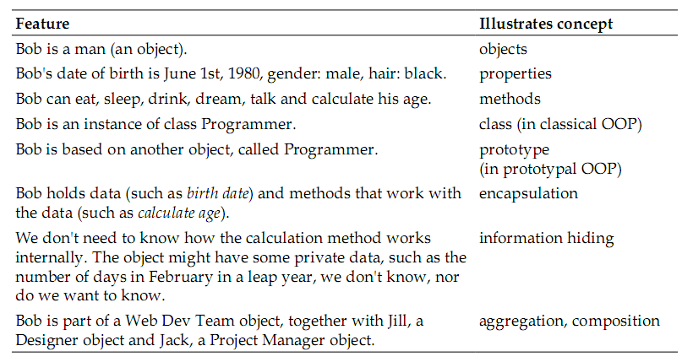
OOP concepts summary

Slide 14
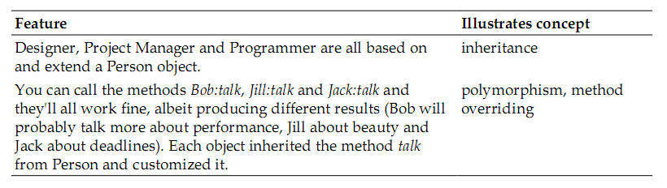
OOP concepts summary (cont.)

Slide 15
TO-DO list
Define JavaScript
Set up environment
Revisit OOP concepts
Look at JavaScript basics
Delve into JavaScript’s core concepts and concerns

Slide 16
JavaScript basics
Data types
Variables
Common operators
Data structure - Array
Flow control statements
Comments

Slide 17
Data types
Primitive:
Number
String
Boolean
Undefined (a variable that doesn’t exist or that hasn’t been initialized)
Null (also considered an object)
Non-primitive (objects)

Slide 18
Data type (cont.)
Group | Data type | typeof(variable) | Special values
Primitive | Number | “number” | Infinitive NaN
 | String | “string” | \ \\ \’ \” \n \r \t \u \b \v \f
 | Boolean | “boolean” | true/false
 | Undefined | “undefined”
 | Null | “object”
Non-primitive | Function | “function”
 | Other object | “object”

Slide 19
Notes on numbers
Number format:
10
012
0xA, 0xa
1e1, 1E1, 1e+1, 1E+1
10.0
Infinity
NaN

Slide 20
Notes on strings
String format:
var s1 = “10”;
var s1 = ‘10’;
String operations:
1 + ‘2’ → ‘12’
‘1’ + 2 → ‘12’
1 * ‘2’ → 2
‘1’ * 2 → 2
1 * ‘2a’ → NaN
‘1’ * ‘abc’ → NaN

Slide 21
Notes on booleans
Boolean format:
var b1 = true, b2 = false;
Most values convert to true, except for these falsy values:
The empty string “” (not the string “ ”)
null
undefined
The number 0 (not the string ‘0’)
The number NaN
The boolean false
Use double negation to convert a value to its boolean equivalent, e.g. !!”one”

Slide 22
Notes on null and undefined
Number + null → Number + 0
Number + undefined → NaN
!!null → false
!!undefined → false
String + null → String + “null”
String + undefined → String + “undefined”

Slide 23
Variables
Declaration & assignment
var a;
var a, b, c;
var a = 5;
var a = 5, b = “abc”;
Variables are case-sensitive
var a = 5, A = “abc”;

Slide 24
Common operators
Arithmetic operators:
+ - * / % ++ --
typeof operator
String operator: +
Logical operators (lazy evaluation):
! && ||
Comparison operators:
== === != !== > >= < <=
Ternary operator: ?
* Use parentheses instead of relying on operator precedence. This makes your code easier to read and understand.
* Note: NaN == NaN → false

Slide 25
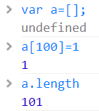
Data structure - Array
An array:
Can contain elements of different data types
Is 0-based
Allows access to its non-existent elements
Sample:
var a = [], b = [1, 2, 3];
typeof(a[2]) -> undefined
a[2] = 1 → [undefined, undefined, 1]
a[0] = ‘a’ → [‘a’, undefined, 1]
delete a[2] → [‘a’, undefined, undefined]
a[1] = b → [‘a’, [1, 2, 3], undefined]
a[1][1] → 2

Slide 26
Flow control statements
if condition
switch statement
while, do-while, for, and for-in loops

Slide 27
if condition
Syntax
Example
if (condition) { statements } if (condition) { statements } else { statements } if (condition) { statements } else if (condition) { statements } else { statements }
if (you.age >= 20) { you.canDrinkBeer = true; } if (you.age >= 20) { you.canDrinkBeer = true; } else { you.hasToDrinkMilk = true; } if (mike.isHuman()) { alert(“Mike, you will die.”); } else if (mike.isGod()) { alert(“Mike, you don’t exist.”); } else { alert(“Mike, who are you?”); }

Slide 28
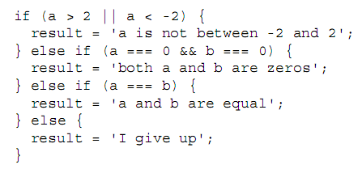
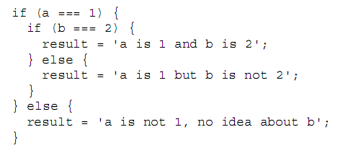
if condition (cont.)
In between the if and the else, there can also be an unlimited number of else if conditions
You can also nest conditions by putting new conditions within any of the blocks

Slide 29
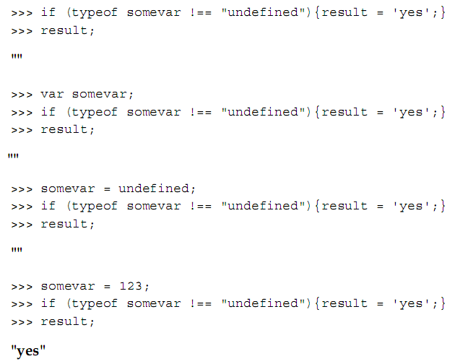
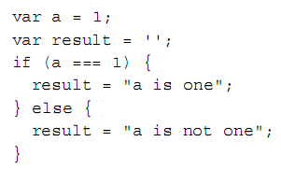
if condition (cont.)
A recommended way to check if a variable exists
Alternative if syntax

Slide 30
switch statement
Syntax
Example
switch (expression) { case expression: statements
case expression: statements
… default: statements }
var a = '1';
var result = '';
switch (a) {
case 1:
result = 'Number 1';
break;
case '1':
result = 'String 1';
break;
default:
result = 'I don\'t know';
break;
}
result;

Slide 31
switch statement (cont.)
Tips
Example
Instead of using an if condition with too many else if parts, use a switch
Indent the case line, and then further indent the code that follows it
Don't forget to break
Use the default case
You can omit break to let your statements fall through to a break:
switch(month){
case 1:
case 3:
alert(month + ‘ is 1 or 3');
break;
case 5:
alert('5');
case 7:
alert('5 or 7');
default:
alert('default');
break;
}

Slide 32
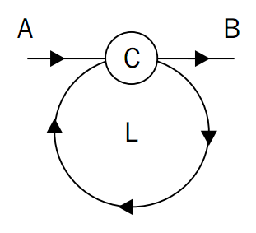
while loop
Syntax
Example
while (condition) { statements }
var you = {age: 0};
while (you.age < 10){
you.age++;
}
alert("Oh, I grew " + you.age +
" years old in a second.");

Slide 33
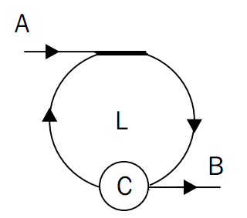
do-while loop
Syntax
Example
do { statements } while (condition);
var you = {age: 0};
do {
you.age++;
} while (you.age < 10);
alert("Oh, I grew " + you.age +
" years old in a second.");

Slide 34
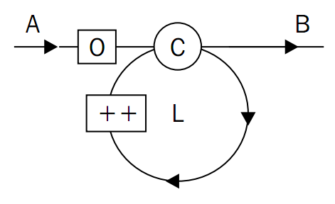
for loop
Syntax
Example
for (init; condition; update) { statements }
var punishment = '';
for (var i = 0; i < 100; i++) {
punishment += 'I will never do this again, ';
}
alert(punishment);

Slide 35
for-in loop
Syntax
Example
for (variable in object) { if (filter) { statements } }
for (variable in object) { if (object.hasOwnProperty(v)) { statements } }
Example 1:
var a = ['a','b','c','x','y','z'];
var result = '\n';
for (var i in a) {
result += 'index: ' + i + ', value: '
+ a[i] + '\n';
}
alert(result);
Example 2:
var result = '\n';
var mike = {
name : 'Mike',
age : 20
};
for (var p in mike){
if (mike.hasOwnProperty(p)) {
result += p + ' = ' + mike[p] + '\n';
}
}
alert(result);

Slide 36
Comments
Single line comments (start with // and end at EOL)
// beginning of line
var a = 1; // anywhere on the line
Multi-line comments (start with /* and end with */ on the same line or any subsequent line)
/* multi-line comment on a single line */
/*
comment
that spans
several lines
*/
* Commented code will be ignored

Slide 37
Quiz
What is the result of executing each of these lines in the console? Why?
var a; typeof a;
var s = '1s'; s++;
!!"false"
!!undefined
typeof -Infinity
10 % "0"
undefined == null
false === ""
typeof "2E+2"
a = 3e+3; a++;
What is the value of v after the following?
var v = v || 10;
Experiment by first setting v to 100, 0, null, or unset it (delete v).
Write a script that prints out the multiplication table. Hint: use a loop nested inside another loop.

Slide 38
TO-DO list
Define JavaScript
Set up environment
Revisit OOP concepts
Look at JavaScript basics
Delve into JavaScript’s core concepts and concerns

Slide 39
Core concepts and concerns
Concepts:
Function
Object
Prototype
Inheritance
Concerns:
Browser environment
Coding and design patterns

Slide 40
TO-DO list revised
…
Delve into JavaScript’s core concepts and concerns
Function
Object
Prototype
Inheritance
Browser environment
Coding and design patterns

Slide 41
TO-DO list continued
…
Delve into JavaScript’s core concepts and concerns
Function
Object
Prototype
Inheritance
Browser environment
Coding and design patterns

Slide 42
Function
How to define and use a function
Passing parameters to a function
Pre-defined functions that are available to you "for free"
The scope of variables in JavaScript
The concept that functions are just data, albeit a special type of data
Functions in advance

Slide 43
Define and use a function
Syntax
Example
Define a function:
// Way 1
function funcName(parameters){
statements
}
// Way 2
var funcName = function (params){
statements
};
Use it:
funcName(arguments);
Define a function:
// Way 1
function greet(name){
alert(“Hello” + name);
}
// Way 2
var greet = function (name){
alert(“Hello” + name);
};
Use it:
greet(“Mike”);

Slide 44
Function parameters
Any skipped parameter will be assigned the value undefined
If you pass more parameters than the function expects, the extra parameters will be silently ignored
All arguments passed to a function is accessible within that function via the arguments array
An argument passed to a function will become available as a local variable

Slide 45
Pre-defined functions
parseInt()
parseFloat()
isNaN()
isFinite()
encodeURI()/encodeURIComponent()
decodeURI() /decodeURIComponent()
eval()

Slide 46
Variable scopes
Global scope
Can be declared in 2 ways:
Declared using var outside of any function
Declared anywhere without the var statement
Local scope
Declared using var inside a function
Function scope, not block scope
Local variable overwrites any global variable with the same name

Slide 47
Function is a special data type
Function literal notation proves that functions are data:
var greet = function (name){
alert(“Hello” + name);
};
alert(greet);
delete greet;
Functions are a special kind of data in that:
They contain code
They are executable

Slide 48
Functions in advance
Function features
Anonymous functions
Callbacks
Self-invoking functions
Inner functions (functions defined inside functions)
Functions that return functions
Functions that redefine themselves
Closures

Slide 49
Function features
Non-blocking
Simulate concurrency and asynchrony:
setTimeout()
setInterval()
Ajax calls
WebWorker
Tips
Make functions as small as possible
Apply concurrency and asynchrony properly

Slide 50
Anonymous functions
Passed as a parameter to another function like callback functions
function invokeAndAdd(a, b){
return a() + b();
}
invokeAndAdd(
function(){return 1;},
function(){return 2;}
);

Slide 51
Anonymous functions (cont.)
Defined and executed right away (self-invoking functions)
(function (name){
alert(“Hello “ + name);
}) (“Mike”);
* Best suited for one-off or initialization tasks

Slide 52
Inner functions
Way 1:
function a(param) {
function b(theinput) {
return theinput * 2;
};
return 'The result is ' + b(param);
};
Way 2:
var a = function(param) {
var b = function(theinput) {
return theinput * 2;
};
return 'The result is ' + b(param);
};

Slide 53
Functions that return functions
Define:
function a() {
alert('A!');
return function(){
alert('B!');
};
}
Use:
a()(); // way 1
var b = a(); b(); // way 2

Slide 54
Functions that redefine themselves
Redefine from the outside:
// use the previously-defined function a()
a = a();
Redefine from the inside:
function a() {
alert('A!');
a = function(){
alert('B!');
};
}

Slide 55
Closure
Lexical scope:
Functions create their scope when they are defined, not when they are executed
Functions remember the environment where they were defined
Scope chain:
Global scope is the root of the chain
Scope of a function not defined inside any function includes:
Global scope
Its local scope
Scope of a function defined inside another function includes:
Its local scope
Its parents’ scope
The chain can be as long (deep) as you want

Slide 56
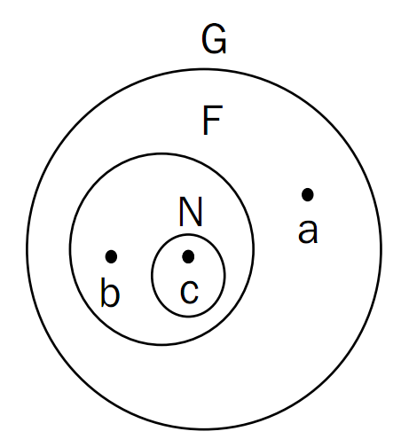
Closure (cont.)
In our example:
G: Global scope
F: a function
a: a global variable
b: a local variable of F
N: an inner function of F
c: a local variable of N
Closure happens when somehow N breaks out of F and ends up in the global space

Slide 57
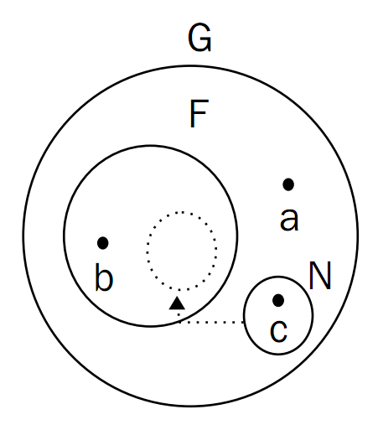
Closure (cont.)
N is now in the same global space as a. However, since functions remember the environment in which they were defined, N will still have access to the F-space, and hence can access b, while a can not.
A closure is created when a function keeps a link to its parent's scope even after the parent has returned.

Slide 58
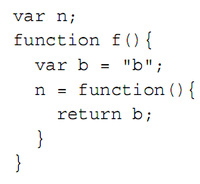
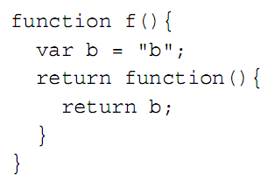
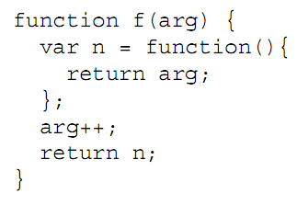
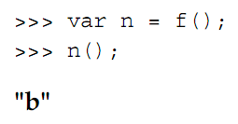
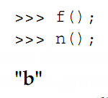
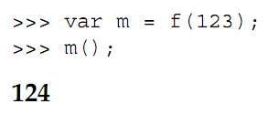
Closure (cont.)
#1: A global function can access f()’s private space
#2: The global function in #1 can be defined inside f(), too
#3: A function binds to its scope, not to the current variables and their values found in the scope.

Slide 59
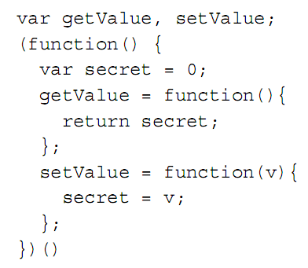
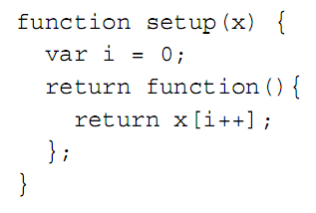
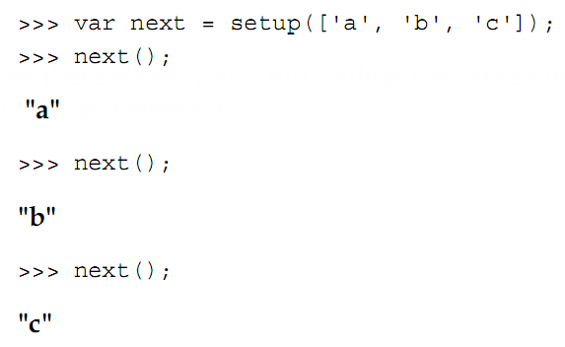
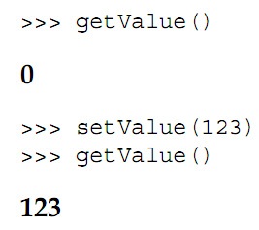
Using closure
#1: getter/setter functions
#2: Iterator functionality

Slide 60
Quiz
Write function getRGB() that converts a hexadecimal color like "#0000FF“, into its RGB representation "rgb(0, 0, 255)". Test it with this:
>>> var a = getRGB("#00FF00");
>>> a;
"rgb(0, 255, 0)"
What does each of these lines print in the console?
>>> parseInt(1e1)
>>> parseInt('1e1')
>>> parseFloat('1e1')
>>> isFinite(0/10)
>>> isFinite(20/0)
>>> isNaN(parseInt(NaN));

Slide 61
Quiz (cont.)
What does this following code alert()?
var a = 1;
function f() {
var a = 2;
function n() {alert(a);}
n();
}
f();
All these examples alert "Boo!". Can you explain why?
1. var f = alert;
eval('f("Boo!")');
2. var e;
var f = alert;
eval('e=f')('Boo!');
3. (function() {return alert;}) () ('Boo!');

Slide 62
TO-DO list
…
Delve into JavaScript’s core concepts and concerns
Function
Object
Prototype
Inheritance
Browser environment
Coding and design patterns

Slide 63
Object
Objects vs. arrays
What to do with objects:
Create, use, pass and compare them
Alter their properties/methods
The this value and the global object
Constructor functions and the constructor property
Built-in objects and what they can do for you

Slide 64
Objects vs. arrays
 | Object | Array
Concept | A list of values with custom-defined keys | A list of indexed values
Terminology | - Property | Element
 | - Method (property that contains a function) | - We seldom use array elements to contain functions
Literal notation | {key: value, key: value, etc.} | [value, value, etc.]
Accessing element | - Use dot notation E.g. hero.occupation - Use square bracket notation E.g. hero[‘occupation’] | - Use square bracket notation E.g. hero[‘occupation’]

Slide 65
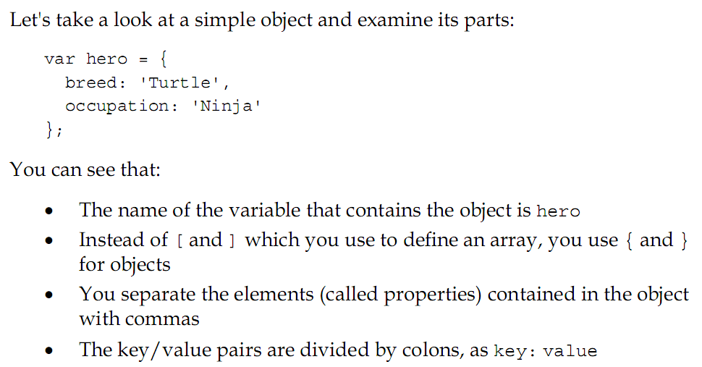
Create objects

Slide 66
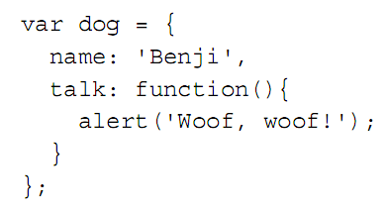
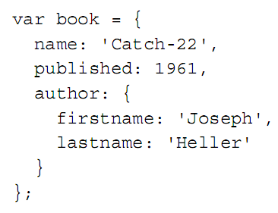
Create objects (cont.)
Object can contain normal data and functions
Object can contain other objects

Slide 67
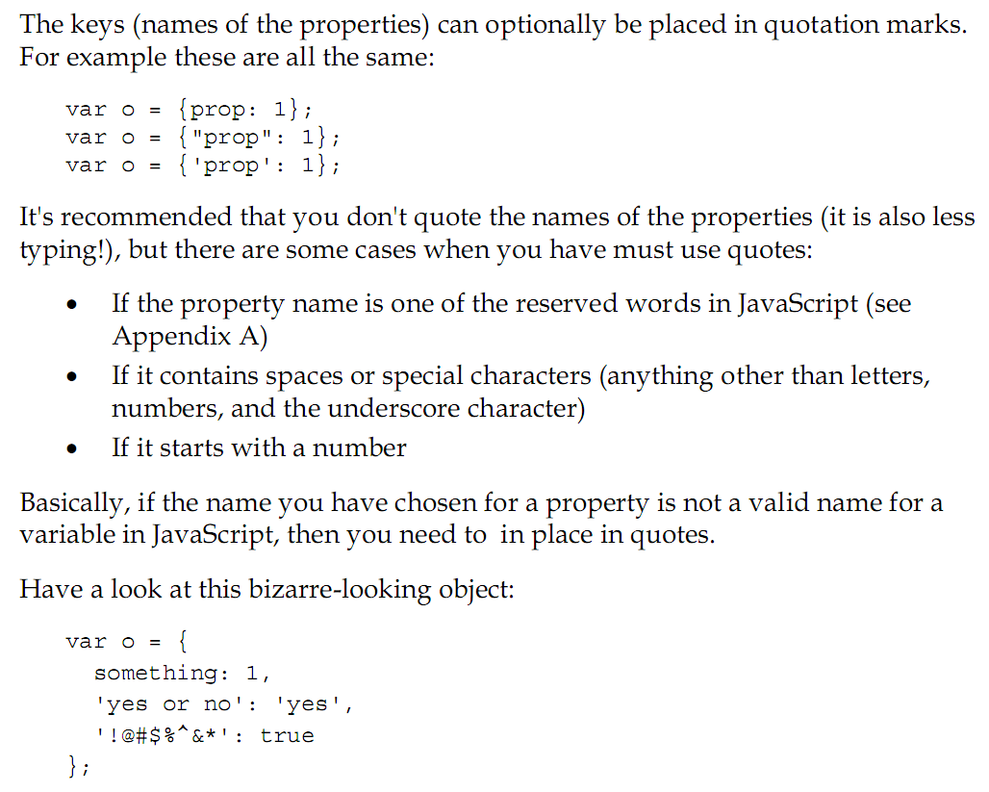
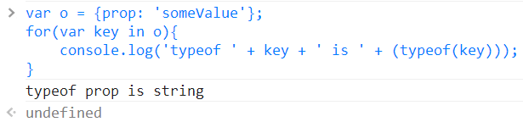
Create objects – Small note
NOTE: Keys are always strings

Slide 68
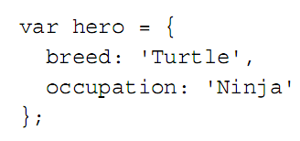
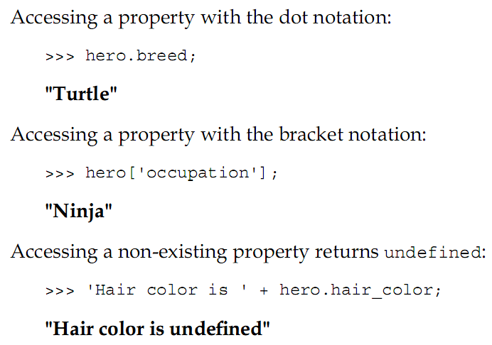
Use objects

Slide 69
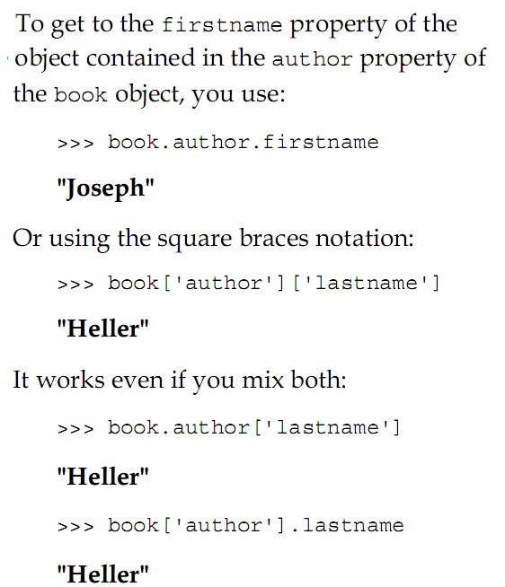
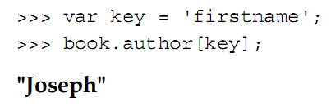
Use objects (cont.)

Slide 70
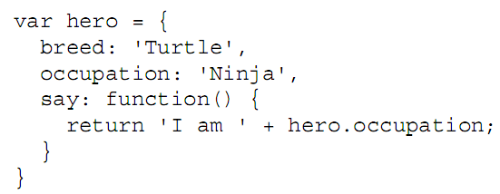


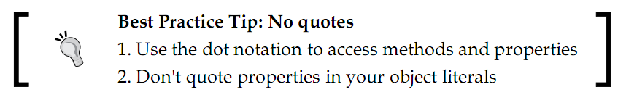
Use objects (cont.)

Slide 71
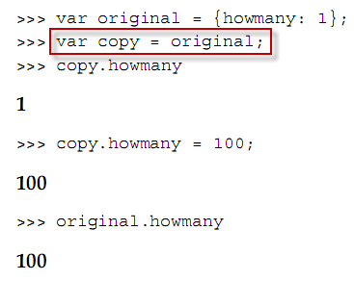
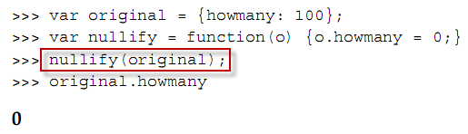
Copy or pass objects
When you copy an object or pass it to a function, you only pass a reference to
that object.

Slide 72
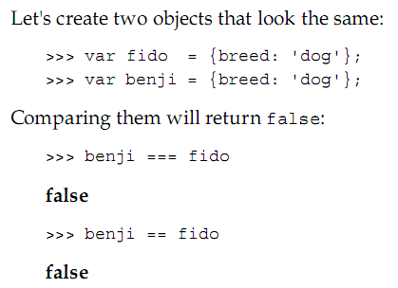
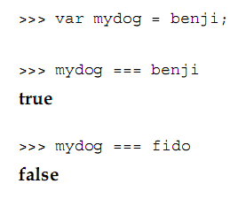
Compare objects
When you compare objects, you'll get true only if you compare 2 references to the same object. There is no stuff like equals() to override. So, comparing 2 distinct objects that have the exact same methods and properties will also return false.

Slide 73
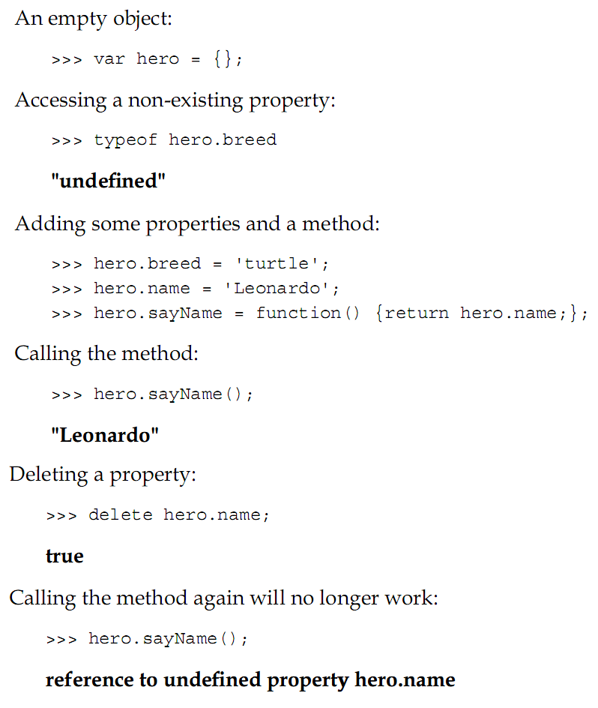
Alter properties/methods

Slide 74
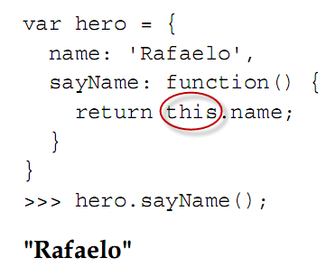
this value
This object, or the current object

Slide 75
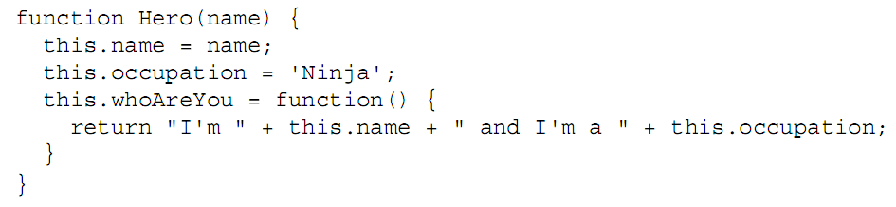
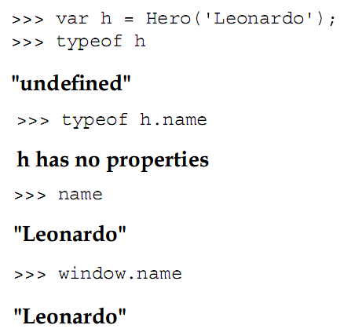
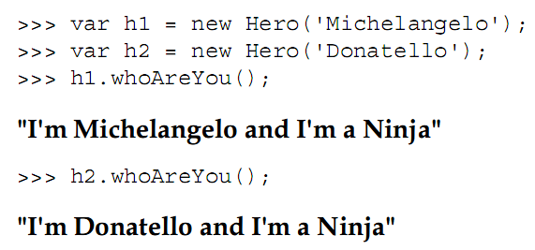
this and the global object
Without new. In this case, this refers to the global object.
The host environment provides a global object and all global variables are actually properties of the global object.
If your host environment is the web browser, the global object is called window.
Global object

Slide 76
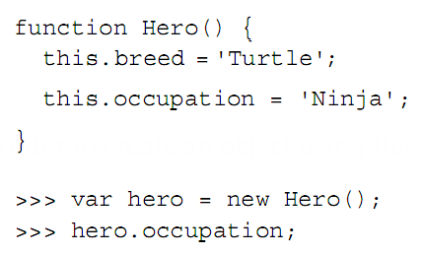
Constructor function
#1: Object literal notation
#2: Constructor function

Slide 77
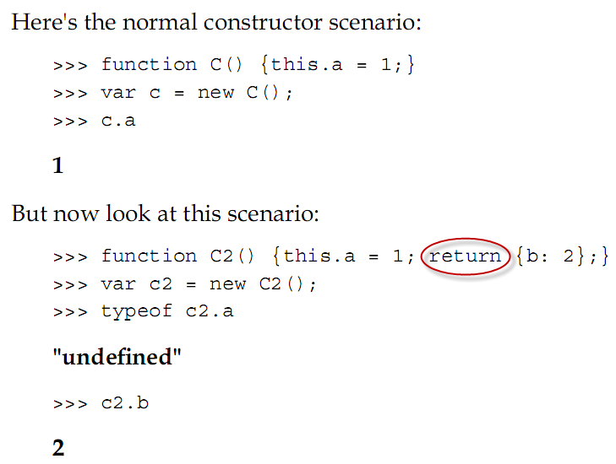
Function that returns objects
If you don’t return anything or try to return something that is not an object, the constructor will proceed with its usual behavior and return this.

Slide 78
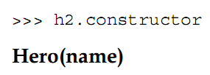
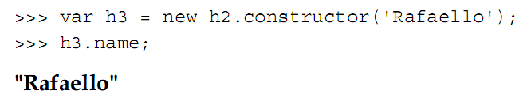
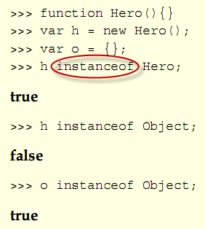
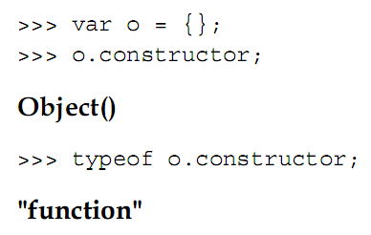
constructor property
If an object was created using the object literal notation, its constructor is the built-in Object() constructor function
Use the instanceof operator to test if an object was created with a specific
constructor function

Slide 79
Built-in objects
Data wrapper objects
Object, Array, Function
Boolean, Number, String
Utility objects
Math (built-in global object)
Date, RegExp
Error object
Error (the parent error)
EvalError, RangeError, ReferenceError, SyntaxError, TypeError, URIError

Slide 80
Quiz
Look at this code:
function F() {
function C() { return this; }
return C();
}
var o = new F();
The value of this refers to the global object or the object o?
What's the result of executing this piece of code?
function C(){
this.a = 1;
return false;
}
console.log(typeof new C());

Slide 81
Quiz (cont.)
What's the result of executing the following piece of code?
>>> c = [1,2,[1,2]];
>>> c.sort();
>>> c.join('--');
>>> console.log(c);
Imagine Math didn't exist. Create a MyMath object that provides these methods:
MyMath.rand(min, max, inclusive) - generates a random number between min and max, inclusive if inclusive is true (default)
MyMath.min(array)—returns the smallest number in a given array
MyMath.max(array)—returns the largest number in a given array

Slide 82
TO-DO list
…
Delve into JavaScript’s core concepts and concerns
Function
Object
Prototype
Inheritance
Browser environment
Coding and design patterns

Slide 83
Prototype
Every function has a prototype property which we can add properties to and use them as own properties
Own and prototypal properties are different
Special stuffs:
isPrototypeOf()
hasOwnProperty()
propertyIsEnumerable()
__proto__
We can enhance built-in objects, such as arrays or strings, via the prototype property

Slide 84
Function object reviewed
Property:
constructor
length
caller
prototype
arguments (with callee property)
Local variable:
this
Method:
call()
apply()

Slide 85
The prototype property
It is only useful when the function is used as a constructor
All objects created with that function keep a reference to the prototype property and can use its properties as their own
The prototype property contains an object
We can add properties to that object and use them as own properties

Slide 86
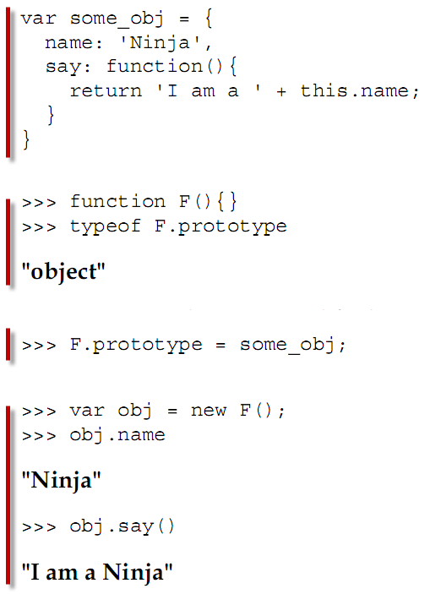
The prototype property (cont.)

Slide 87



Add members using prototype
Way 1 – Add to the existing
Way 2 - Replace

Slide 88

Add members using prototype (cont.)
The prototype is "live“: Objects are passed by reference in JavaScript, and therefore the prototype is not copied with every new object instance. It means that you can modify the prototype at any time and all objects (even those created before the modification) will inherit the changes.

Slide 89



Add members using prototype (cont.)
The prototype is “replaceable“: Each instance holds a reference to the prototype when created, not always the current prototype of the constructor function
Oh, phoneGadget still references the old prototype

Slide 90


Add members using prototype (cont.)

Slide 91
Own vs. prototypal properties
Object
Object
Own properties and methods
Prototype
Own properties and methods
Prototype
Note:
Own properties take precedence over prototypal properties having the same name.
When we modify a prototypal property, we actually create a new own property with the same name.
We can delete own properties of an object.
In the constructor function, own properties are added using this.

Slide 92


Own vs. prototypal properties (cont.)
When seeing newtoy.rating, the JavaScript engine will examine all of the properties of newtoy and will not find the one called rating. Then the engine will identify the prototype of the constructor function used to create this object (newtoy.constructor.prototype). If the property is found in the prototype, this property is used.
When seeing newtoy.rating, the JavaScript engine will directly examine all of the properties of the prototype property and will find the one called rating and use it.
The end results are the same. However, using this is simpler, and using prototype is faster for prototypal properties.

Slide 93


Own vs. prototypal properties (cont.)
Actually, a new own property has been created and it hides any proptotypal properties having the same name

Slide 94

Own vs. prototypal properties (cont.)
phone
name = “Phone”
color = “black”
whatAreYou()
price = 200
price = 100
getInfo()
phone2
name = “Phone 2”
color = “blue”
whatAreYou()
price = 100
getInfo()
phone3
name = “Phone 3”
color = “red”
whatAreYou()
price2 = 100
getInfo2()

Slide 95

Enumerate properties
Just remind! Each JavaScript object is similar to a HashTable-like structure. So, enumerating its properties is just like looping through a HashTable.

Slide 96
Special stuffs
isPrototypeOf()
monkey.isPrototypeOf(george) returns true to mean “object monkey is used as the prototype of object george”
hasOwnProperty()
monkey.hasOwnProperty(“name”) returns true if object monkey has an own property called name
propertyIsEnumerable()
monkey.propertyIsEnumerable('name') returns true if object monkey has an own property called name and that property is not built-in
__proto__
The secret link every object keeps to its prototype (Firefox only)

Slide 97


Enhance built-in objects
- Although it’s possible to enhance built-in objects, don’t abuse it. Remember that what you consider a missing feature today and decide to augment a prototype for, might be a built-in method tomorrow.
- If you decide to augment the prototype of built-in objects with a new property, do check for existence of the new property frst.

Slide 98
Exercises
Create an object called shape that has a type property and a getType() method.
Define a Triangle() constructor function whose prototype is shape. Objects created with Triangle() should have three own properties—a, b, c
Add a new method to the prototype called getPerimeter().

Slide 99
Exercises (cont.)
Test your implementation with this code:
>>> var t = new Triangle(1, 2, 3);
>>> t.constructor
Triangle(a,b,c) Triangle(a, b, c)
>>> shape.isPrototypeOf(t)
true true
>>> t.getPerimeter()
6 6
>>> t.getType()
"triangle" "triangle"
Loop over t showing only own properties and methods (none of the prototype's).
Make this code work:
>>> [1,2,3,4,5,6,7,8,9].shuffle()
[2, 4, 1, 8, 9, 6, 5, 3, 7]

Slide 100
TO-DO list
…
Delve into JavaScript’s core concepts and concerns
Function
Object
Prototype
Inheritance
Browser environment
Coding and design patterns

Slide 101
Prototype chaining reviewed
Object
Object
Own properties and methods
Prototype
Own properties and methods
Prototype

Slide 102




Inheritance

Slide 103
Inheritance (cont.)
Triangle object
TwoDShape object
Shape object
name
side
height
getArea()
Prototype
name
Prototype
name
toString()
Prototype
Triangle constructor object
TwoDShape constructor object
Shape constructor object
name
side
height
getArea()
Prototype
name
Prototype
name
toString()
Prototype

Slide 104

Inheritance (cont.)
In this improved version, we did:
- Move shared members (that don’t change between instances) to the Prototype
- Take care of inheritance first before augmenting the prototype

Slide 105
Inheritance (cont.)
Triangle object
TwoDShape object
Shape object
side
height
Prototype
name
getArea()
Prototype
name
name
toString()
Triangle constructor object
TwoDShape constructor object
Shape constructor object
side
height
Prototype
name
getArea()
Prototype
name
name
toString()

Slide 106

Inheritance (cont.)
In this improved version, we did:
- Inherit the object contained in Shape.prototype, not the object created with new Shape()
We gain a little more effciency by:
- Not creating a new object
- Having less lookups during runtime when it
comes to searching for toString() for example.
But we also has a side effect:
- Because all children and parents point to the same object, when a child modifes the prototype, the parents get the changes, and so do the siblings.

Slide 107
Inheritance (cont.)
Triangle object
TwoDShape object
Shape object
side
height
Prototype
Prototype
name
toString()
getArea()
Triangle constructor object
TwoDShape constructor object
Shape constructor object
side
height
Prototype
Prototype
name
toString()
getArea()

Slide 108

Inheritance (cont.)
The previous solution poses a problem: all prototypes point to the same object and the parents get children's properties.
We can solve this using an intermediary in the form of a temporary constructor function:
- Create an empty function F()
- Set its prototype to the prototype of the parent constructor
- Set new F() to the prototype of the child constructor (new F() creates objects that have no properties of their own, but inherit everything from the parent's prototype)
This approach supports the idea that only properties and methods added to the prototype should be inherited, and own properties should not.

Slide 109
Inheritance (cont.)
Triangle object
F constructor object
F constructor object
side
height
Prototype
Always empty
Prototype
Always empty
Prototype
F object
F object
name
getArea()
Prototype
name
Prototype
Triangle constructor object
TwoDShape constructor object
Shape constructor object
side
height
Prototype
Prototype
name
toString()

Slide 110

Uber – Access to the parent
In JavaScript, there is no special syntax for a child to access its parent’s methods (like super in Java), but it's easy to achieve the same functionality by, for example, creating an uber property that points to the parent's prototype object.
Actually, uber can be replaced by any other name, but should not be “superclass” or “super”. (The German word "über" suggested by Douglass Crockford, means more or less the same as "super“)

Slide 111
Inheritance patterns (IP) - Classification
Patterns that work with:
Constructors
Objects
Patterns that:
Use the prototype chain
Copy properties
Do both (copy properties of the prototype)

Slide 112




Inheritance patterns (cont.)
Way 1
Way 2
Way 3
Way 4

Slide 113


Inheritance patterns (cont.)
Way 5
Way 6
Quiz:
- Do you have any other ways?
- Compare the good and bad points of these ways.
- Can you implement multi-inheritance?

Slide 114


IP - Multi-inheritance
Way 7
mixin is a popular term in some languages such as Ruby. A mixin is similar to an object that provides some useful functionality but is not meant to be inherited and extended by sub-objects.
The multi() approach here implements the mixins idea. When you create a new object, you can pick and choose any other objects to mix into your new object. By passing them all to multi(), you get all their functionality without making them part of the inheritance tree.

Slide 115

IP - Parasitic inheritance
Way 8
Parasitic inheritance means using a function that creates objects by:
- Taking all of the functionality of another object
- Augmenting it
- Returning it
As you can see, triangle() is a normal function, not a constructor, it doesn't require the new operator. But because it returns an object, calling it with new by mistake will work in exactly the same way.

Slide 116

IP - Constructor-borrowing
Way 9a
In this pattern, the parent's own properties are recreated as the child's own properties (as opposed to children's prototype properties as was the case in the prototype-chaining pattern).
- Benefit: if a child inherits an array or other object, it's a completely new value (not a reference) and modifying it won't affect the parent.
- Drawback: the parent's constructor gets called twice: once with apply() to inherit own properties and once with new to inherit the prototype. In fact the own properties of the parent will be inherited twice.

Slide 117

IP - Constructor-borrowing (cont.)
Way 9b
We can avoid double inheritance by:
- Calling apply() on the parent constructor to get all own properties
- Then copying the prototype's properties using a simple iteration (e.g. extend2())
Benefit: we can access uber if needed.

Slide 118
Inheritance patterns (cont.)
… There are more patterns

Slide 119

Try a demo
Visit here: http://www.phpied.com/files/canvas/
Open a JavaScript console:
Firebug console in Firefox
Developer console in Chrome
…
Try this:
var p1 = new Point(100, 100);
var p2 = new Point(300, 100);
var p3 = new Point(200, 0);
var t = new Triangle(p1, p2, p3);
t.draw();
var r = new Rectangle(new Point(200, 200), 50, 100);
r.draw();
var s = new Square(new Point(130, 130), 50);
s.draw();
new Square(p1, 200).draw();
You can also try getArea(), getPerimeter()

Slide 120
Excercises
Make a comparison table for the afore-mentioned inheritance patterns
Read the source code of the previous demo, and:
Draw some triangles, squares, and rectangles
Add constructors for more shapes, such as Trapezoid, Rhombus, Kite, Diamond, Pentagon, and Circle. Remember to overwrite the draw() method of the parent.
Can you think of another way to approach the problem and use some other type of inheritance?
Pick a method that uses uber as a way for a child to access its parent. Add functionality where the parents can keep track of who their children are. Perhaps by using a property that contains a children array?

Slide 121
TO-DO list
…
Delve into JavaScript’s core concepts and concerns
Function
Object
Prototype
Inheritance
Browser environment
Coding and design patterns

Slide 122
Browser environment
… For self-reference

Slide 123
TO-DO list
…
Delve into JavaScript’s core concepts and concerns
Function
Object
Prototype
Inheritance
Browser environment
Coding and design patterns

Slide 124
Coding and design patterns
… For self-reference

Slide 125
TO-DO list
…
Delve into JavaScript’s core concepts and concerns
Function
Object
Prototype
Inheritance
Browser environment
Coding and design patterns

Slide 126
Back to our main TO-DO list
Define JavaScript
Set up environment
Revisit OOP concepts
Look at JavaScript basics
Delve into JavaScript’s core concepts and syntaxes

Slide 127
TO-DO list for next time
...
Delve into JavaScript’s core concepts and concerns
jQuery, Jodo, …
JSON
JavaScript in real-world applications
…

Slide 128

Scope

Slide 129
Scope
Scope is a place where variables are defined and can be accessed
JavaScript has only two types of scopes
Global scope and function scope
Global scope is the same for the whole web page
Function scope is different for every function
Everything outside of a function scope is inside of the global scope
if(true){
var sum = 1+2;
}
console.log(sum);

Slide 130
Scope
Scope is a place where variables are defined and can be accessed
JavaScript has only two types of scopes
Global scope and function scope
Global scope is the same for the whole web page
Function scope is different for every function
Everything outside of a function scope is inside of the global scope
if(true){
var sum = 1+2;
}
console.log(sum);
The scope of the if is the global scope. sum is accessible from everywhere
The scope of the if is the global scope. sum is accessible from everywhere

Slide 131
Global Scope
The global scope is the scope of the web page
Or the Node.js app
Objects belong to the global scope if:
They are define outside of a function scope
They are defined without var
Fixable with 'use strict'
function arrJoin(arr, separator) {
separator = separator || "";
arr = arr || [];
arrString = "";
for (var i = 0; i < arr.length; i += 1) {
arrString += arr[i];
if (i < arr.length - 1) arrString += separator;
}
return arrString;
}

Slide 132
Global Scope
The global scope is the scope of the web page
Or the Node.js app
Objects belong to the global scope if:
They are define outside of a function scope
They are defined without var
Fixable with 'use strict'
function arrJoin(arr, separator) {
separator = separator || "";
arr = arr || [];
arrString = "";
for (var i = 0; i < arr.length; i += 1) {
arrString += arr[i];
if (i < arr.length - 1) arrString += separator;
}
return arrString;
}
arr, separator and i belong to the scope of printArr

Slide 133
Global Scope
The global scope is the scope of the web page
Or the Node.js app
Objects belong to the global scope if:
They are define outside of a function scope
They are defined without var
Fixable with 'use strict'
function arrJoin(arr, separator) {
separator = separator || "";
arr = arr || [];
arrString = "";
for (var i = 0; i < arr.length; i += 1) {
arrString += arr[i];
if (i < arr.length - 1) arrString += separator;
}
return arrString;
}
arr, separator and i belong to the scope of printArr
arrString and arrJoin belong to the global scope

Slide 134
Global Scope (2)
The global scope is one of the very worst parts of JavaScript
Every object pollutes the global scope, making itself more visible
If two objects with the same identifier appear, the first one will be overridden

Slide 135

Global Scope
Live Demo

Slide 136
Function Scope
JavaScript does not have a block scope like other programming languages (C#, Java, C++)
{ and } does not create a scope!
Yet, JavaScript has a function scope
Function expressions create scope
Function declarations create scope
if(true)var result = 5;
console.log(result);//logs 5
if(true) (function(){ var result = 5;})();
console.log(result);//ReferenceError
function logResult(){ var result = 5; }
if(true) logResult();
console.log(result); //ReferenceError

Slide 137

Function Scope
Live Demo

Slide 138
Resolving References through the Scope Chain
JavaScript resolves the object references due to the simple rule "Closer is better":
if a function outer() declares object x, and its nested function inner() declares object x:
outer() holds a reference to the outer x
inner() holds a reference to the inner x
function outer(){ var x = 'OUTER';
function inner(){
var x = 'INNER';
return x;
}
inner();
return { x: x, f: inner };
}

Slide 139
Resolving References through the Scope Chain
Live Demo

Slide 140
ECMAScript 6 Way of Working with Scopes
ECMAScript 6 introduces a new way to handle scopes:
The key word 'let'
let is much like var
Creates a variable
But, let creates a block scope
Yet, still not supported
Can be used with Babel.js or Traceur
if(false){
var x = 5;
let y = 6;
}
console.log(x); //prints undefined
console.log(y); //throws error

Slide 141
Block scope with let
Live Demo

Slide 142
Closures

Slide 143
Closures
Closures are a special kind of structure
They combine a function and the context of this function
function outer(x){
function inner(y){
return x + " " + y;
}
return inner;
}

Slide 144
Closures
Closures are a special kind of structure
They combine a function and the context of this function
function outer(x){
function inner(y){
return x + " " + y;
}
return inner;
}
inner() forms a closure. It holds a reference to x

Slide 145
Closures
Closures are a special kind of structure
They combine a function and the context of this function
function outer(x){
function inner(y){
return x + " " + y;
}
return inner;
}
inner() forms a closure. It holds a reference to x
In the context of f1, x has value 5
var f1 = outer(5);
console.log(f1(7)); //outputs 5 7

Slide 146
Closures
Closures are a special kind of structure
They combine a function and the context of this function
function outer(x){
function inner(y){
return x + " " + y;
}
return inner;
}
inner() forms a closure. It holds a reference to x
In the context of f1, x has value 5
var f1 = outer(5);
console.log(f1(7)); //outputs 5 7
In the context of f2, x has value "Peter"
var f2 = outer("Peter");
console.log(f2("Petrov")); //outputs Peter Petrov

Slide 147
Simple Closures
Live Demo

Slide 148
Closures Usage
Closures can be used for data hiding
Make objects invisible to the outside
Make them private
var school = (function() {
var students = [];
var teachers = [];
function addStudent(name, grade) {...}
function addTeacher(name, speciality) {...}
function getTeachers(speciality) {...}
function getStudents(grade) {...}
return {
addStudent: addStudent,
addTeacher: addTeacher,
getTeachers: getTeachers,
getStudents: getStudents
};
})();

Slide 149
Closures Usage
Closures can be used for data hiding
Make objects invisible to the outside
Make them private
var school = (function() {
var students = [];
var teachers = [];
function addStudent(name, grade) {...}
function addTeacher(name, speciality) {...}
function getTeachers(speciality) {...}
function getStudents(grade) {...}
return {
addStudent: addStudent,
addTeacher: addTeacher,
getTeachers: getTeachers,
getStudents: getStudents
};
})();
This is actually called a Module

Slide 150
2) JS & DOM / XPATH

Slide 151

XPath
Xpath – language to navigate and find information in XML document
Uses path expressions to navigate XML documents
Contains a library of standard functions

Slide 152
Xpath Path Expressions/Functions
Xpath uses path expressions
Use path expressions to select nodes/node-sets in XML documents
Path expressions – similar to computer file system
Xpath includes more than 100 functions
Functions for string and numeric values, date/time comparison, node/QName manipulation, Boolean values etc.

Slide 153
XPath Nodes - terminology
Seven kinds of nodes:
Element
Attribute
Text
Namespace
Processing-instruction (PI)
Comment
Document nodes
Atomic values – nodes without children or parent
Items – atomic values or nodes

Slide 154

XPath Nodes - relationship
Types of relationship:
Parent
Children
Siblings
Ancestors
Descendants

Slide 155
XPath Syntax
Selecting nodes
Expression | Description
nodename | Selects all child nodes of the named node
/ | Selects from the root node
// | Selects nodes in the document from the current node that match the selection no matter where they are
. | Selects the current node
.. | Selects the parent of the current node
@ | Selects attributes

Slide 156
XPath Syntax
Predicates – used to find a specific node/node with a specific value
Path Expression | Results
/katalog/kereta [1] | Select the first “kereta” element that is the child of “katalog” element (in IE, use kereta[0])
/katalog/kereta [last()] | Select the last “kereta” element
/katalog/kereta [position()<3] | Select the first two “kereta” elements that are the children of the “katalog” element
/katalog/kereta [price>50000] | Select all the “kereta” elements of the “katalog” element with price greater than 50000

Slide 157
XPath Wildcards/| operator
Wildcards to select unknown XML elements
Use ‘|’ to select several paths
Wildcard | Description
* | Matches any element node
@* | Matches any attribute node
node() | Matches any node of any kind
Path Expression | Results
//kereta/model | //kereta/harga | Select all “model” AND “harga” elements of all “kereta” elements
//tahun | //cc | Select all the “tahun” AND “cc” elements

Slide 158
More XPath References
XPath Axes - http://www.w3schools.com/xpath/xpath_axes.asp
XPath Operators - http://www.w3schools.com/xpath/xpath_operators.asp
XPath functions (with XQuery, XSLT) - http://www.w3schools.com/xpath/xpath_functions.asp

Slide 159
XPath Example
Using Javascript – using “kereta.xml”
Edit the “ex1.html” , “ex2.html” and “ex3.html” files
Understand the usage of XPath and Javascript

Slide 160
XSLT
Extensible Stylesheet Language Transformation

Slide 161
Displaying XML
XML documents don’t carry information about how to display data
3 ways to display data:
XSLT (Extensible Stylesheet Transformation Language)
CSS (Cascading Style Sheet)
JavaScript

Slide 162
XSL
XSL – Extensible Stylesheet Language
Style sheets for XML
Describes how the XML document should be displayed
Consisted of:
XSLT – transforming XML documents
XPath – navigating XML documents
XSL-FO – formatting XML documents

Slide 163
XSL Transformation
XSLT – XSL Transformation
Transform XML documents to other formats (e.g. XHTML) – transform each XML element to XHTML element
Supported by all major browsers
Most important part of XSL
Allows adding/removing elements and attributes to/from output file, rearranging/sorting elements, perform test etc.

Slide 164
XSLT - Transformation
Example of a transformation – steps:
Start with a raw XML document
Declare stylesheet
Create XSL style sheet
Link style sheet to the XML document

Slide 165
<?xml version="1.0" encoding="ISO-8859-1"?> <xsl:stylesheet version="1.0" xmlns:xsl="http://www.w3.org/1999/XSL/Transform"> <xsl:template match="/"> <html> <body> <h2>My CD Collection</h2> <table border="1"> <tr bgcolor="#9acd32"> <th>Title</th> <th>Artist</th> </tr> <xsl:for-each select="catalog/cd"> <tr> <td><xsl:value-of select="title"/></td> <td><xsl:value-of select="artist"/></td> </tr> </xsl:for-each> </table> </body> </html> </xsl:template> </xsl:stylesheet>
XSLT example

Slide 166
XSLT Example
Using “kereta.xml”
Create/Edit the XSLT files to show various combination of sorting, filtering, formatting etc.
Understand the usage of XSLT

